Slide 1

CEIR Importer Training Manual

Slide 2

Agenda
Importer Definition and Overview
Assumptions
Features
Registration
Dashboard
Type Approval Request
Consignment
Stock Management
Grievance
Profile Management

Slide 3
Importer - Definition
An entity who interact with suppliers of Mobile devices or any SIM based devices and have business agreement with such suppliers to bring the SIM based devices in Cambodia for Cambodia based users to use.
Importer is responsible for paying the Import duty to Cambodian customs.
Importer can be Distributor or Retailer as well or both.

Slide 4
Overview

Slide 5
Importer – Roles
Pls note Buying and selling of devices are done outside the scope of CEIR system.

Slide 6
Assumption

Slide 7
Registration – Importer

Slide 8
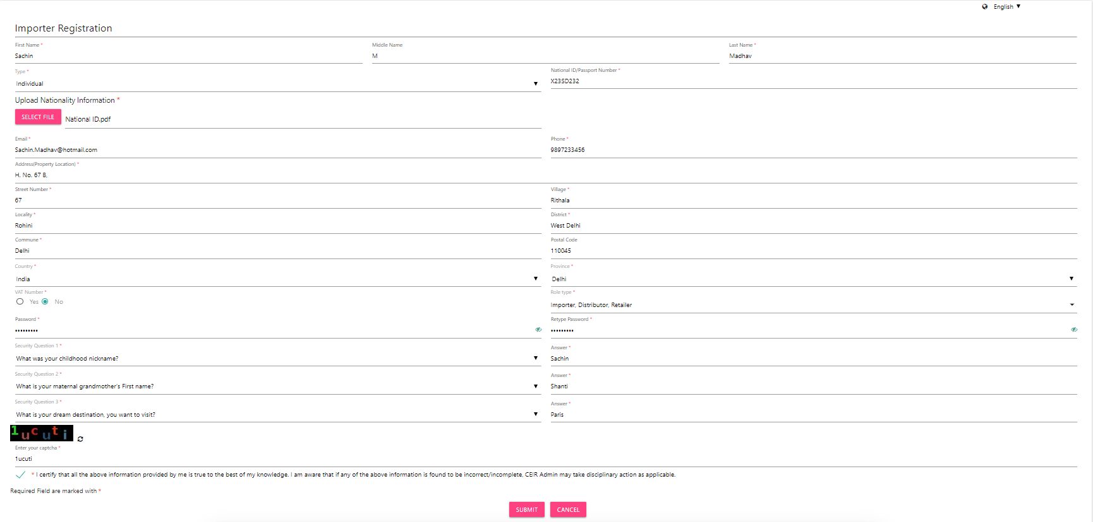
Registration – Importer (Form)

Slide 9
Dashboard – Importer

Slide 10
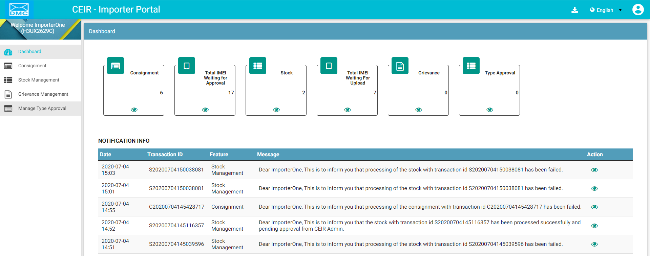
Dashboard – Importer
Download User Manual
Left Panel
Work Area
All features status
Edit Profile
Language Change
On click it takes user to respective home page
Notifications

Slide 11
Type Approved – Importer
Whenever Importer wish to purchase new devices from his supplier, Importer should have valid TAC certificate from the TRC (Telecommunication Regulator of Cambodia).
This TAC certificate related information has to be uploaded in the CEIR system before registering the consignments which have the new TAC associated with them.
In case, an Importer fails to upload the TAC information before raising the consignment, CEIR system gives an option to upload the TAC information before the consignment reaches the CUSTOM.
Once the consignment is at CUSTOMs and CEIR system does not find the TAC information, the consignments will be rejected by the CUSTOMs.
For special cases, Importers can produce the TAC information to the CUSTOMs at the time of clearance of consignment. But that TAC certificate related information has to be uploaded in the CEIR system for future references.

Slide 12
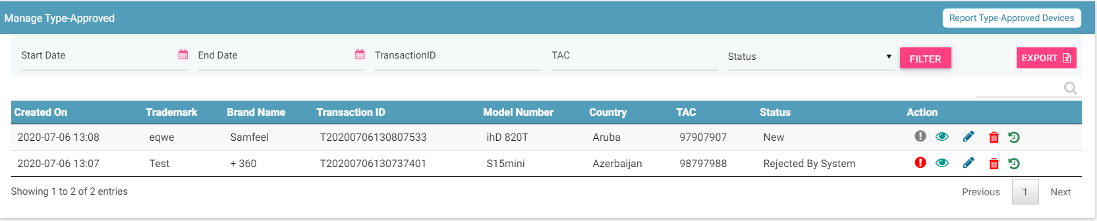
Type Approval – Importer
Request Type Approval
Filters
Export
Action like View, Edit & Delete
View All requests

Slide 13
Consignment – Importer
Importers purchase consignments from suppliers.
After a consignment is ordered, the importer must register the consignment in the CEIR system.
TAX has to be paid for the consignment before it is sold to Distributor/ Retailer/ End-user.
Importer must furnish the following details for registering a consignment
Supplier/Manufacturer Name and ID
Consignment number
Expected dispatch and arrival date
Device Origin Country
IMEI and Device Quantity
Quantity and Total Price of the consignment based on which the TAX is calculated
Expected arrival port
Port Address
Bulk devices information file. This file has to be in CSV format.
Importer can also download the format which is accepted by the CEIR system from the Register Consignment form.

Slide 14
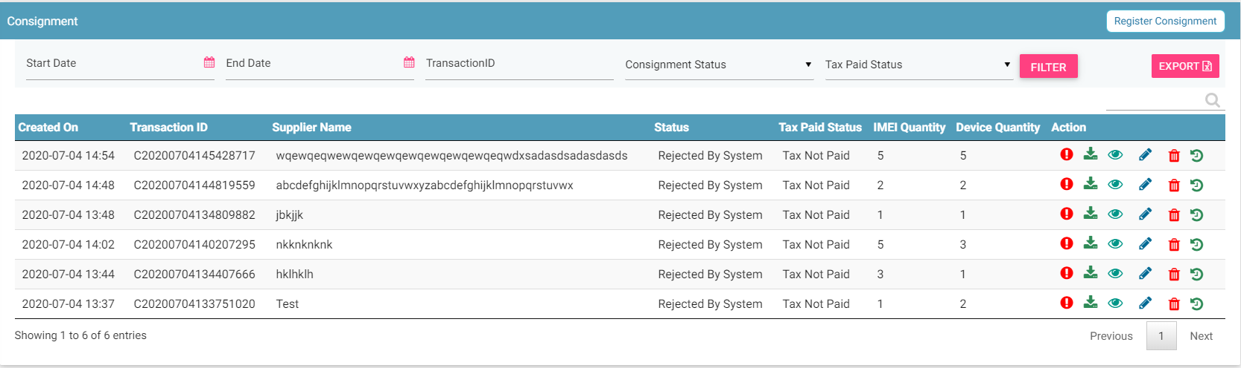
Consignment – Importer
Register
Export
Filters
Action like View, Delete
View All Consignment
© 2019-2020 Sterlite Technologies Limited
14

Slide 15
Stock Management – Importer

Slide 16
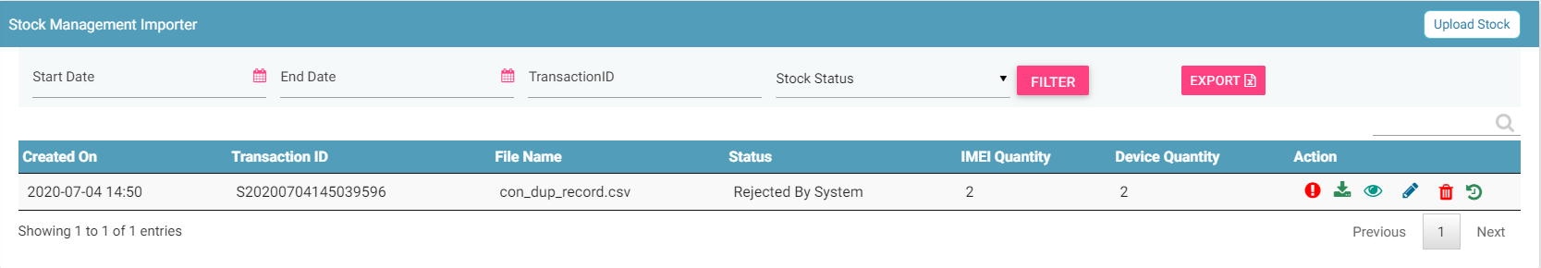
Stock Management – Importer
Export
Upload
Filters
Action like View, Delete
View All Stocks

Slide 17
Grievance – Importer

Slide 18
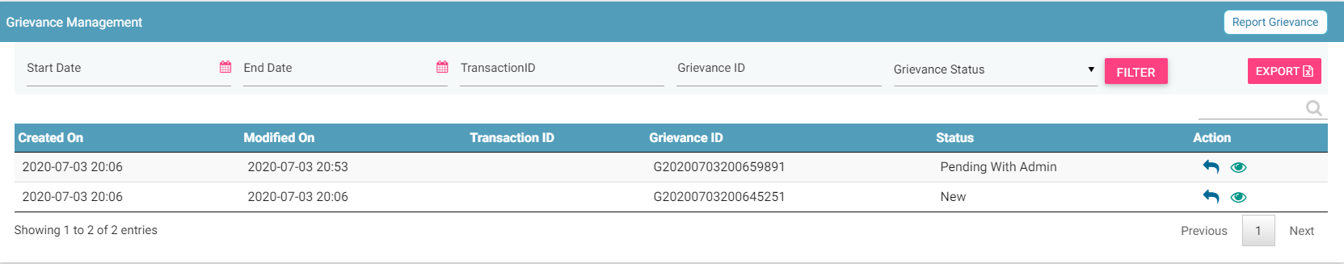
Grievance – Importer
Report
Filters
Export
Action like View, Reply
View All grievances

Slide 19
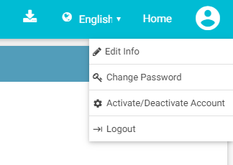
Profile Management – Importer

Slide 20
Queries

Slide 21
Thank You

